Slide 1
Lorann game – Java Project
Presented by Origo Patrick-Ivann ,Bourthoumieux Thomas, Begue Mathieu , Chambefort Hugo

Slide 2

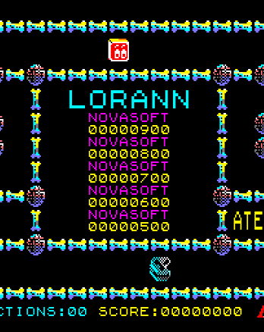
Plan : 1. Introduction 2. Distribution of roles 3. MVC Pattern 4. Diagrams a) Component b) Package c) Class 5. MVC Example a) Controller example b)Model example c)View example 5. Database part

Slide 3
Distribution of roles
BOURTHOUMIEUX Thomas : Leader
ORIGO Patrick-Ivann: Developer
BEGUE Mathieu:
Developer
CHAMBEFORT Hugo:
Developer

Slide 4
MVC Pattern
Sends a user request
Controller
Return to user
Request processing
View
Model
Sent as part of the request
Sent to be
presented to user

Slide 5
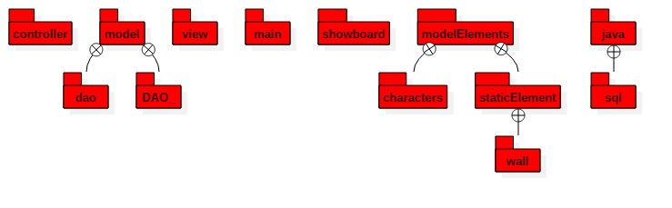
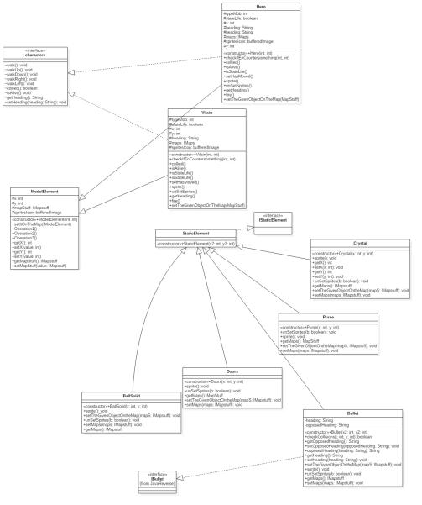
Package diagram
Class diagram

Slide 6
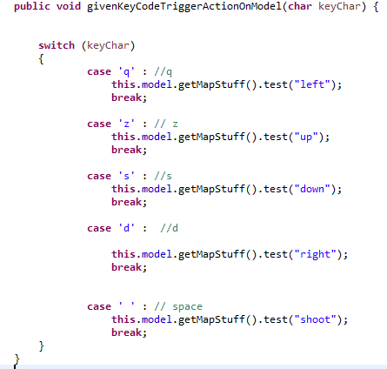
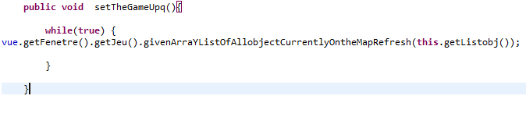
Controller part : Example
Allow the Hero to move with the keyboard
Set the Game Up

Slide 7
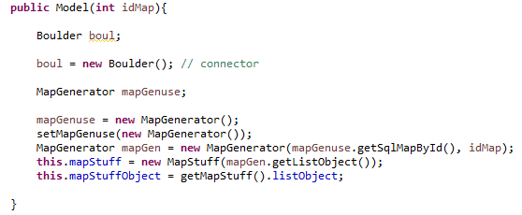
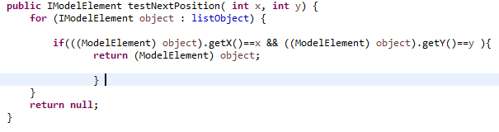
Model part : Example
Generate our map
Test the next position to know if there is a wall

Slide 8
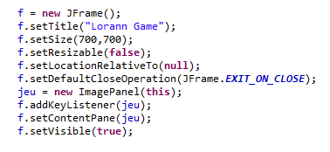
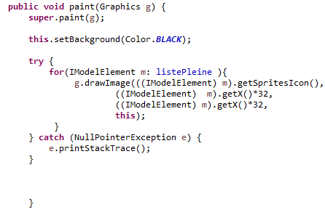
View Part : Example
Create a frame with a size, a title and add our components
Paint the sprites loaded in the frame

Slide 9
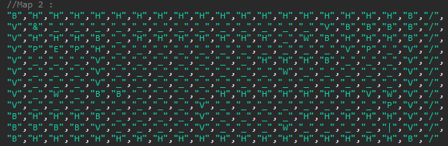
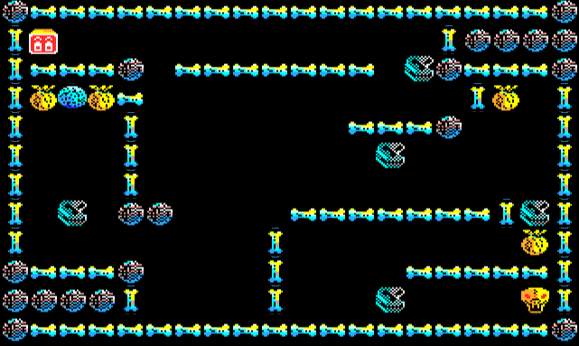
Database part

